Slide 1

Automatic PCB Routing and Placement
Supervised By
Prof Smruti R Sarangi
Prepared By
Anamika Patel

Slide 2
PCB Routing
Advanced process of connecting electrical components on a PCB defining the channels for signal propagation inside the circuit.
Connections are known as traces
This phase has a substantial impact on the performance, dependability, and operation of electrical devices.
Component Placement
Signal Tracing
Power and Ground Routing
Differential Pair Routing
Via Placement
Signal Integrity Analysis
Step-by-Step PCB Routing
Notes:
Here's a Step-By-Step Guide on How to Do PCB Routing Effectively:
Step 1: Component Placement –
Begin by carefully placing components on the PCB layout to improve signal pathways and reduce interference.
Consider component functionality, signal flow, and physical limits while placing.
Step 2: Signal Tracing –
Route traces between components while maintaining signal integrity, impedance matching, and length matching.
To improve signal routes and reduce crosstalk, use routing strategies such as straight-line, meandering, and serpentine routing.
Step 3: Power and Ground Routing -
Route power and ground traces to provide steady power distribution while minimizing noise interference.
Use ground planes and power distribution networks to reduce impedance and voltage drops.
Step 4: Differential Pair Routing –
High-speed communications should be routed using techniques like differential pair routing to maintain signal integrity and minimize distortion.
Ensure exact differential pair routing via regulated impedance and length matching.
Step 5: Via Placement –
Strategically position vias to connect traces between different layers of the PCB and improve signal routes.
Use thru stitching and shielding techniques to reduce signal reflections and impedance fluctuations.
Step 6: Signal Integrity Analysis
After routing, conduct a signal integrity analysis to ensure and optimize signal quality.
Signal integrity analysis tools can be used to analyze signal features such as integrity metrics, reflections, and impedance matching.
Designers can achieve the best performance, durability, and signal integrity in PCB designs by following these procedures and adopting effective routing approaches.

Slide 3
PCB Routing Techniques
Utilizing Routing Software Tools
Layer Stackup Considerations
Routing Strategies for Complex Designs
Signal Integrity Simulation and Analysis
Implementing these effective PCB routing techniques into their design process, designers may improve PCB efficiency, accuracy, and reliability, resulting in high-quality electronic devices with superior performance characteristics.​
​
Notes:
Effective PCB routing is critical for ensuring the best performance and reliability of electrical circuits. Here are four essential approaches that can significantly enhance the routing process and increase the quality of PCB designs.
Utilizing Routing Software Tools - PCB designers can use advanced routing software tools to simplify the routing process. These tools provide features like interactive routing, auto routing, and design rule verification to ensure proper and efficient routing. Designers can save time and reduce errors by using routing software tools to create appropriate trace layouts and signal pathways.
Layer Stackup Considerations - Layer stackup configuration must be carefully planned in order to fit signal, power, and ground layers based on the design's specific needs. When deciding on the layer stackup structure, designers must take into account signal integrity, impedance control, and electromagnetic interference (EMI) mitigation. Optimizing the layer stackup for high-speed circuits reduces signal skew, coupling, and improves signal integrity.
Routing Strategies for Complex Designs - PCB designers must build routing solutions that are suitable for the design's complexity. Component density, signal density, and route limitations are all important factors to consider. Hierarchical routing approaches can be used to better manage large and complicated designs by dividing routing chores into manageable pieces or modules.
Signal Integrity Simulation and Analysis - Signal integrity simulation and analysis with specialist software tools are critical when evaluating the electrical performance of PCB designs. Designers can use impedance, crosstalk, and timing analysis to identify and resolve potential signal integrity issues early in the design process.
By implementing these effective PCB routing techniques into their design process, designers may improve PCB efficiency, accuracy, and reliability, resulting in high-quality electronic devices with superior performance characteristics.

Slide 4
Optimizing PCB Routing
Minimizing Signal Reflections and Crosstalk
Implement impedance matching techniques
Thermal Management
Match Signal Lengths
Optimizing PCB routing is essential for producing high-performance, reliable electrical circuits.
Notes:
Optimizing PCB routing is essential for producing high-performance, reliable electrical circuits. Here are four crucial tips for improving PCB routing efficiency:
Minimizing Signal Reflections and Crosstalk: Minimize signal reflections and crosstalk by routing traces with minimal discontinuities and correct spacing. Use shielding techniques such as ground planes and guard traces to isolate critical signals and reduce interference.
Implement impedance matching techniques: Match the transmission line impedance to the PCB substrate and surrounding components to guarantee consistent signal transmission with minimal distortion. Use impedance-controlled routing and regulated dielectric materials to provide uniform impedance along signal traces.
Match Signal Lengths: Match signal trace lengths to minimize skew and maintain synchronous transmission. Group related signals and route them together to reduce variation in signal propagation delays.
Thermal Management: PCB Thermal management involves efficiently routing power and ground wires to minimize resistance and voltage dips, resulting in less power dissipation and heat creation. Maintain proper spacing and airflow around high-power components to aid in heat dissipation and thermal protection.
Designers can improve the performance and reliability of electronic circuits by following these tips when routing PCBs.

Slide 5
Need of Automatic Routing of PCB
Accelerate PCB product development cycle
Dictation of no of layers required for PCB
Alteration of overall placement of components on the board
Access of tools that optimize the above two processes
Speeding up of these processes through automatic routing
Interleaving of interactive or manual routing operations with automatic tasks
AI based Automatic Routing of PCB
Real-life design constraints are too difficult for the usual approaches
Find solutions that satisfy all constraints in a reasonable time
Leverages past-experience through learning

Slide 6
Software tools for Auto-routing of PCB
3. DeepPCB
4. Flux
2. Altium
5. Pad2Pad tool
1. eCADSTAR tool

Slide 7
eCADSTAR PCB auto-router
Easy access to all the routing tools built into the eCADSTAR PCB editor
Performs 3 levels of checks using built-in ‘expert’ routing consultant
High level check
Medium level check
Low level check
Fully integrated into the PCB editor in an easy to learn environment.
A detailed report from Routing Consultant has suggestions on how to solve issues that have been identified
Using the information gained, a step-by-step routing strategy for the design is generated by the Routing Consultant
High-level check
Medium level check
by the consultant automatically modifying your routing step
Low level check
identifies set-up problems with your design
requires modifications to design rules or even physical layout
Identifies problems that may be solved by either:
altering the design set up or
Identifies problems that can be solved by altering the steps used to complete the auto-routing or manual routing process
Notes:
•https://www.ecadstar.com/en/solution/pcb-software-with-autorouting/

Slide 8

PCB auto routing feature in eCADSTAR

Slide 9
2. Altium
Auto-Interactive Routing
Routes traces using the design rules that you currently have set up
Gives you manual routing results
Auto-interactive routers and PCB auto-routers
Auto-router tries to do the thinking for you whereas,
Auto-interactive router lets you be in charge
Saves you time
Selects the nets- It will route in the same manner that you would have

Slide 10
2. Altium
Auto-Interactive Routing Features
Component auto-placer
Auto router
Design rule check
Arranges all components systematically
Saves precious time by routing a set of signals simultaneously
Best used to complement the best practice of component placement
Component placement takes into account several factors: heat production, sensitivity as well as direction and orientation of signals
Multiple pair and differential pair routing
Use auto-routing alongside manual and interactive routing
Manually placing the power supply, high-speed communication, and analog signals; routing the differential pairs
Completing the remaining signals with auto-routing tool
Maintains equal copper length and ensures they are running in parallel
Ensure that the differential or multiple pairs signal is not routed near other high speed or analog signals
Highlights routing errors and zooms into the exact location on the PCB for immediate remedial work.
Helps eliminate mistakes like unconnected nets or clearance constraints violations,
A compatibility with both features and experience allows the engineer to identify issues like ground loops or incorrect ground plane placement

Slide 11
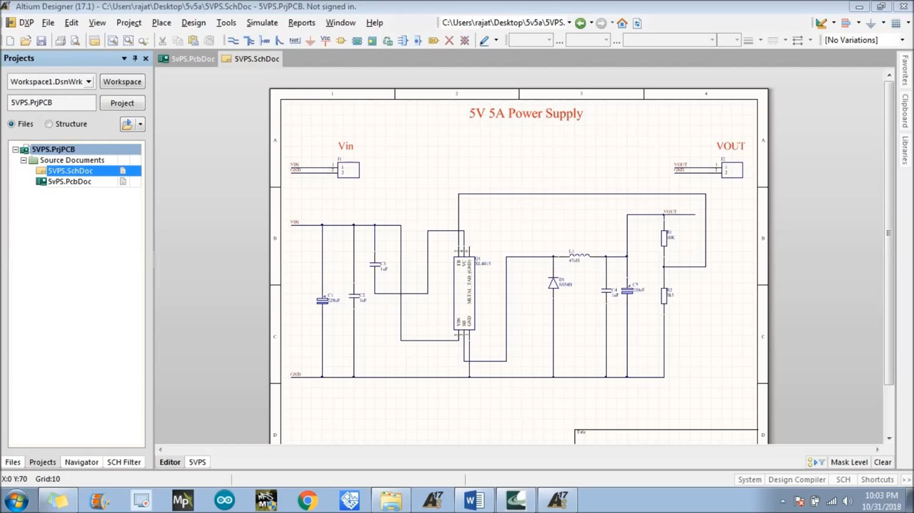
2. Altium
Auto-routing in Altium tool

Slide 12

3. DeepPCB
Choose what to optimise
Get help with routing or combine it with placing the components.
Notes:
•http://deeppcb.ai/

Slide 13
3. DeepPCB
Add board & set constraints
Upload your file and see your board being routed from scratch or ask DeepPCB Pro to consider existing routing.

Slide 14
3. DeepPCB
Start the run
Once you have an initial solution you can either stop the process or let it run further to get better versions.

Slide 15
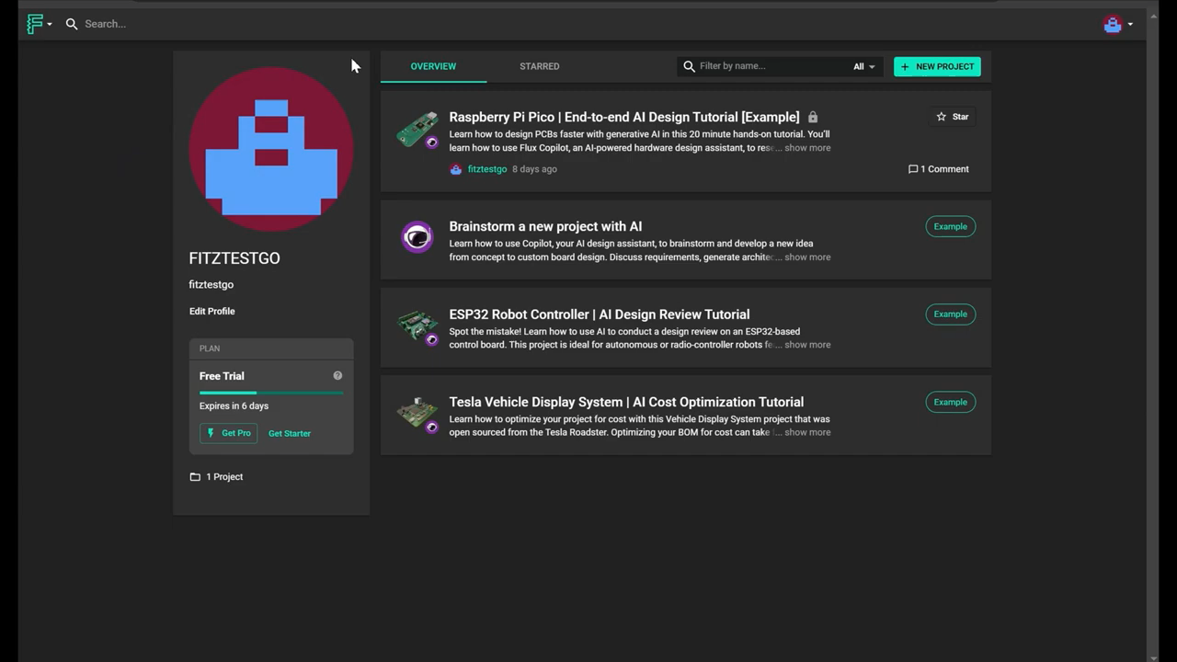
4. Flux: AI auto layout
Notes:
•https://www.flux.ai/p

Slide 16

5. Pad2Pad tool
Notes:
•https://www.pad2pad.com/help/traces-pcb-auto-router/

Slide 17
Thank You!

